Slide 1
MATH2010 Counting and Sets
Le DUY DUNG
College of Engineering and Computer Science

Slide 2

SO YOU THINK YOU CAN COUNT?

Slide 3
Learning Goals
Know the definitions and notation for sets, intersection, union, complement.
Be able to visualize set operations using Venn diagrams.
Understand how counting is used computing probabilities.
Be able to use the rule of sum, rule of product, inclusion-exclusion principle, permutations and combinations to count the elements in a set.

Slide 4
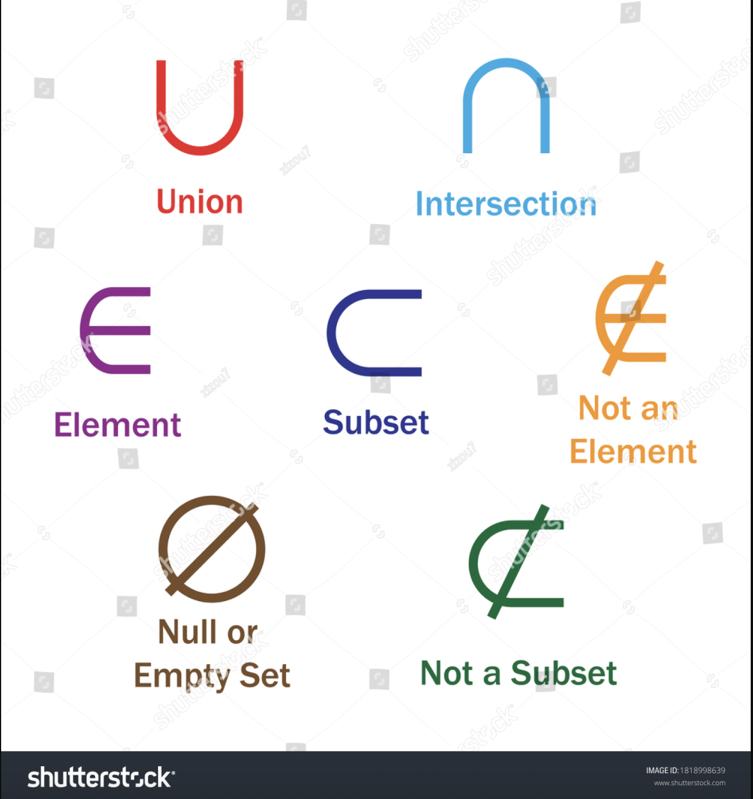
SETS and SET Operations

Slide 5
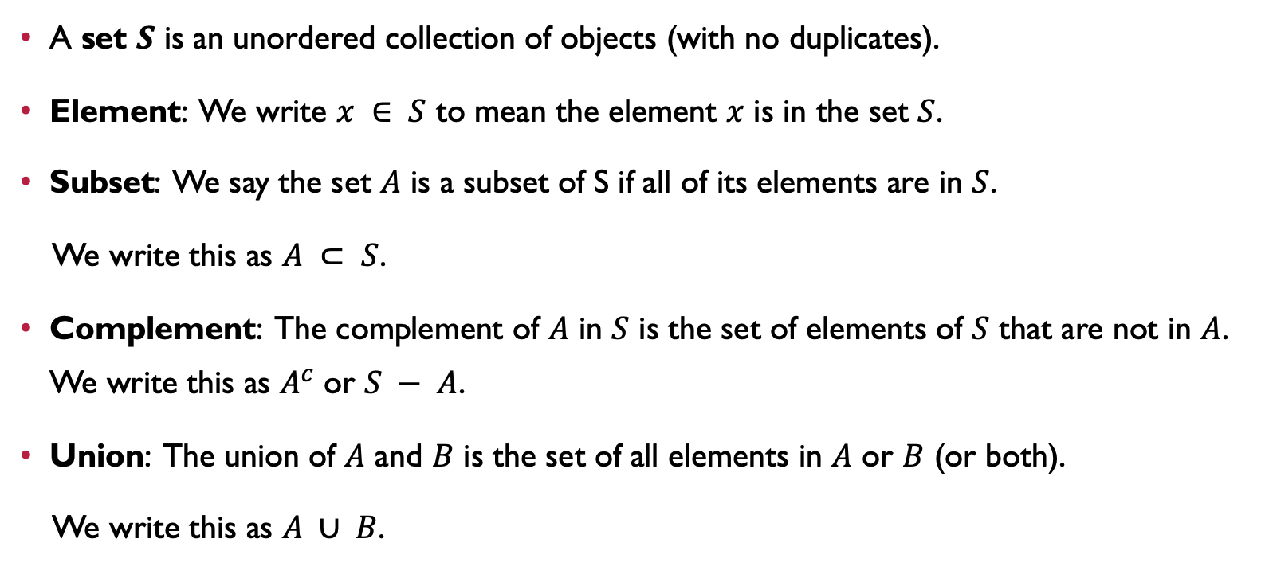
SET Operations
A set $S$ is an unordered collection of objects (with no duplicates).
Element: We write $x ∈ S$ to mean the element $x$ is in the set $S$.
Subset: We say the set $A$ is a subset of S if all of its elements are in $S$.
We write this as $A ⊂ S$.
Complement: The complement of $A$ in $S$ is the set of elements of $S$ that are not in $A$. We write this as $A^{c}$ or $S − A$.
Union: The union of $A$ and $B$ is the set of all elements in $A$ or $B$ (or both).
We write this as $A ∪ B$.

Slide 6
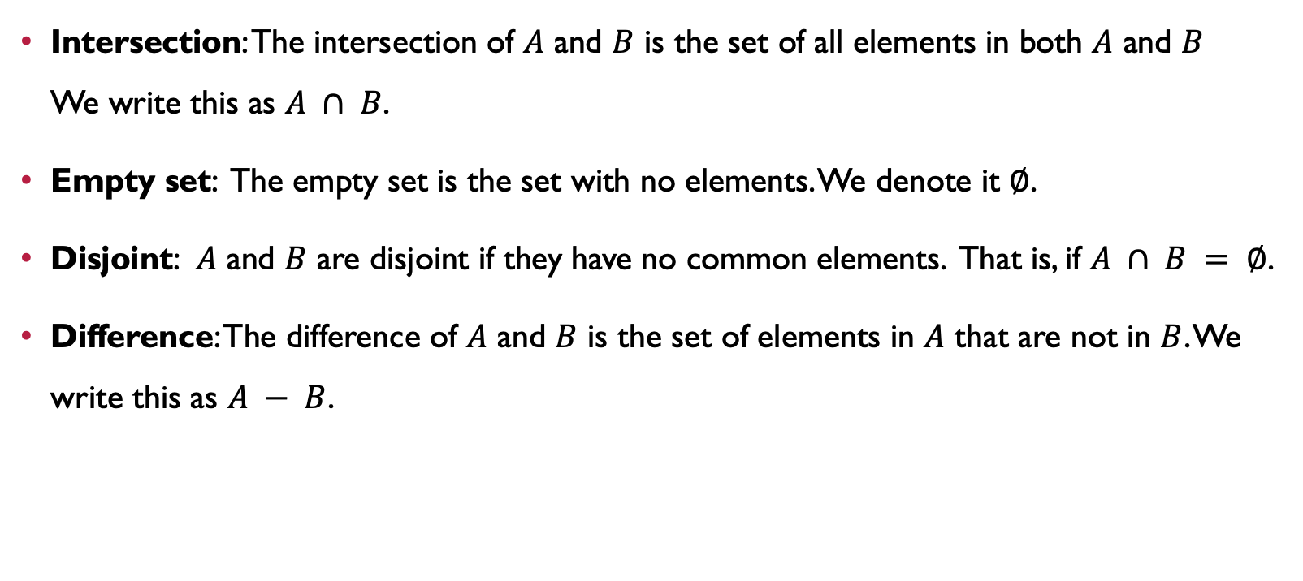
SET Operations
Intersection: The intersection of $A$ and $B$ is the set of all elements in both $A$ and $B$ We write this as $A ∩ B$.
Empty set: The empty set is the set with no elements. We denote it ∅.
Disjoint: $A$ and $B$ are disjoint if they have no common elements. That is, if $A ∩ B = ∅$.
Difference: The difference of $A$ and $B$ is the set of elements in $A$ that are not in $B$. We write this as $A − B$.

Slide 7




Visualize Set Operations with Venn Diagrams
S
A
$$A^{C}= S − A$$
$$A∪B$$
$A∩B$ ???
$A−B$ ????

Slide 8
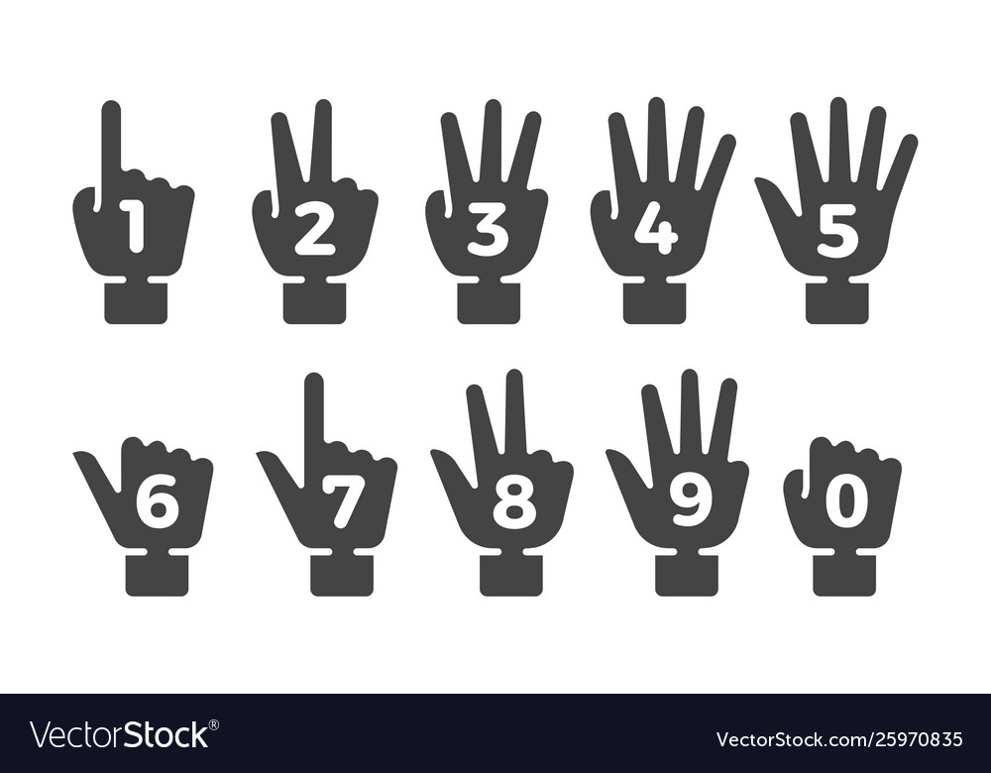
COUNTING

Slide 9
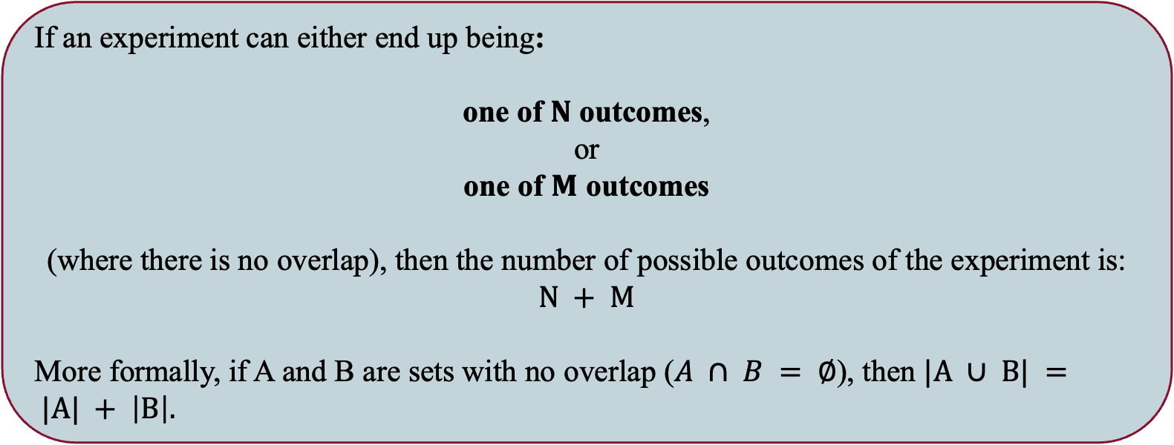
Rule of SUM
If an experiment can either end up being:
one of $N$ outcomes,
or
one of $M$ outcomes
(where there is no overlap), then the number of possible outcomes of the experiment is: $N + M$
More formally, if A and B are sets with no overlap ($A ∩ B = ∅$), then $|A ∪ B| = |A| + \left|B\right|.$

Slide 10
Rule of SUM
Example. Given a complete deck of cards, how many of the cards are either black face cards, or red and even?

Slide 11
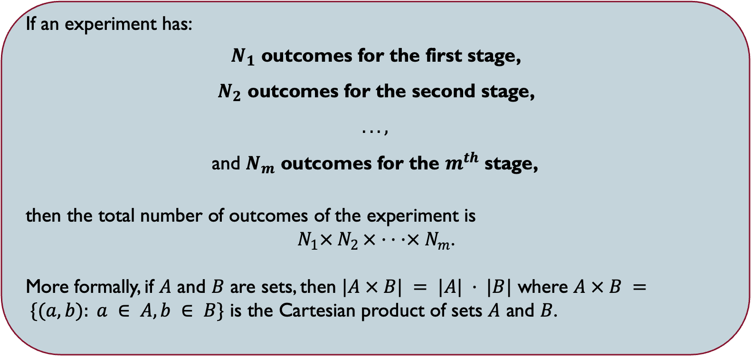
Rule of Product
If an experiment has:
$N_{1}$ outcomes for the first stage,
$N_{2}$ outcomes for the second stage,
$. . . ,$
and $N_{m}$ outcomes for the $m^{th}$ stage,
then the total number of outcomes of the experiment is
$N_{1}×{ N}_{2 }× · · ·× N_{m}$.
More formally, if $A$ and $B$ are sets, then $|A × B| = |A| · |B|$ where $A × B = \{(a, b): a ∈ A, b ∈ B\}$ is the Cartesian product of sets $A$ and $B$.

Slide 12
Rule of Product
Example. Calvin wants to go to Ho Chi Minh city. He can choose from 3 bus services or 2 train services to head from home to Hanoi. From there, he can choose from 3 airline services or 3 train services to head to Ho Chi Minh city. How many ways are there for him to get to Ho Chi Minh city?

Slide 13
Rule of Product
Example. let’s consider how easy or difficult it is for a robber to randomly guess your PIN code. Every debit card has a PIN code of 10 digits that their owners use to withdraw cash from ATMs or to complete transactions. How secure are these PINs, and how safe can we feel?

Slide 14
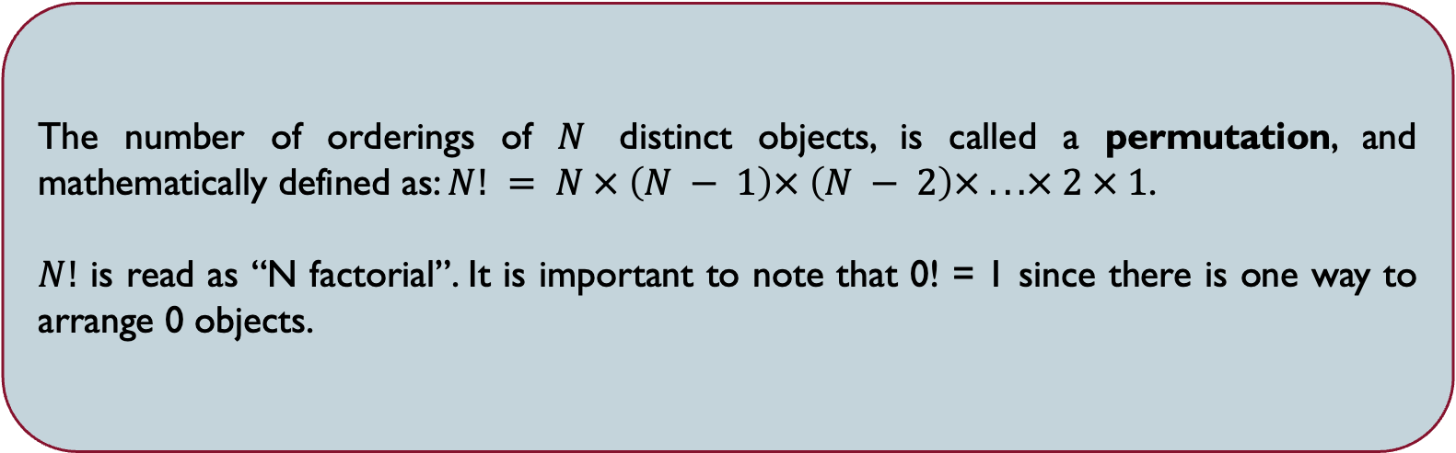
PERMUTATIONS
The number of orderings of $N$ distinct objects, is called a permutation, and mathematically defined as: $N! = N × \left(N − 1\right)× \left(N − 2\right)× . . . × 2 × 1$.
$N!$ is read as “N factorial”. It is important to note that 0! = 1 since there is one way to arrange 0 objects.

Slide 15
PERMUTATIONS
Example. Let’s consider a stronger case of the 10-digit long PIN code example where you must use each digit exactly once. How many such PINs exist?

Slide 16
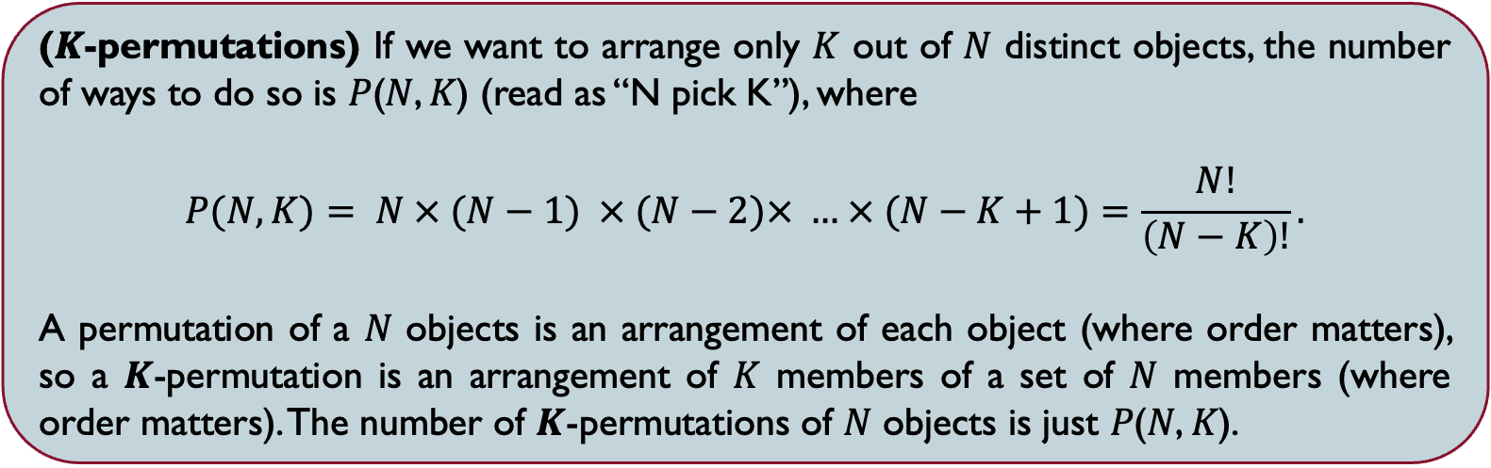
$K$-PERMUTATIONS
(𝑲-permutations) If we want to arrange only 𝐾 out of 𝑁 distinct objects, the number of ways to do so is 𝑃(𝑁, 𝐾) (read as “N pick K”), where
$$P(N, K)= N × (N−1) × (N−2)× … × (N−K+1)=\frac{N!}{\left(N−K\right)!}.$$
A permutation of a 𝑁 objects is an arrangement of each object (where order matters), so a 𝑲-permutation is an arrangement of 𝐾 members of a set of 𝑁 members (where order matters). The number of 𝑲-permutations of 𝑁 objects is just 𝑃(𝑁, 𝐾).

Slide 17
$K$-PERMUTATIONS
Example. Suppose we have 13 chairs (in a row) with 9 TA’s, and Professors Sunny, Rainy, Windy, and Cloudy to be seated. What is the number of seatings where every professor has a TA to his/her immediate left and right?

Slide 18
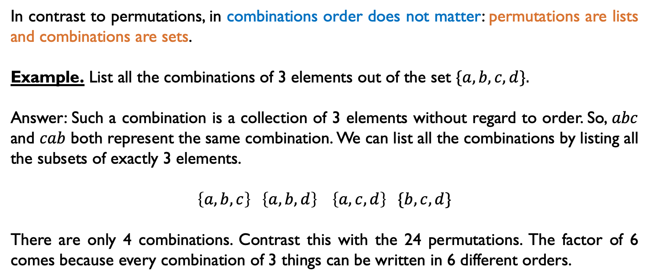
Combinations
In contrast to permutations, in combinations order does not matter: permutations are lists and combinations are sets.
Example. List all the combinations of 3 elements out of the set $\{a, b, c, d\}.$
Answer: Such a combination is a collection of 3 elements without regard to order. So, $abc$ and $cab$ both represent the same combination. We can list all the combinations by listing all the subsets of exactly 3 elements.
$$\left\{a, b, c\right\} \left\{a, b, d\right\} \left\{a, c, d\right\} \{b, c, d\}$$
There are only 4 combinations. Contrast this with the 24 permutations. The factor of 6 comes because every combination of 3 things can be written in 6 different orders.

Slide 19
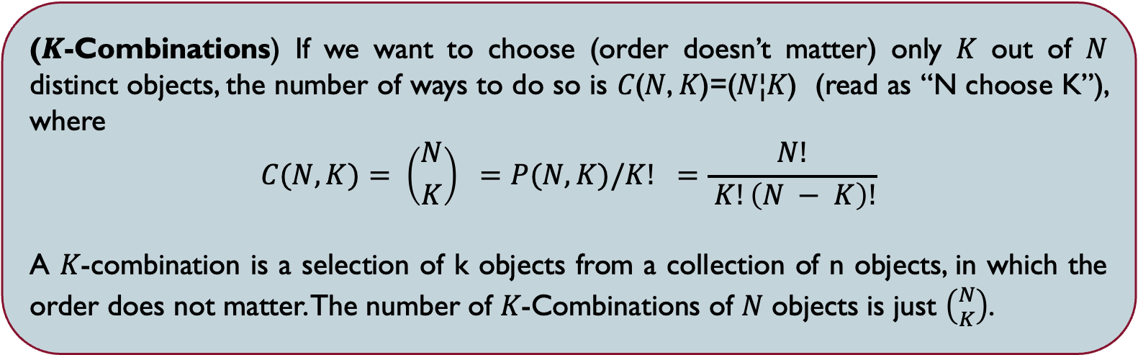
$K$-COMBINATIONS
(𝑲-Combinations) If we want to choose (order doesn’t matter) only 𝐾 out of 𝑁 distinct objects, the number of ways to do so is 𝐶(𝑁, 𝐾)=(𝑁¦𝐾) (read as “N choose K”), where
$$C(N, K)= \left({N \atop K}\right) =P(N, K)/K! =\frac{N!}{ K!\left(N − K\right)!}$$
A 𝐾-combination is a selection of k objects from a collection of n objects, in which the order does not matter. The number of 𝐾-Combinations of 𝑁 objects is just $\left({N \atop K}\right)$.

Slide 20
$K$-COMBINATIONS
Example. There are 6 CECS professors and 7 CBM professors taking part in an escape room. If 4 CECS professors and 4 CBM professors are to be chosen and divided into 4 pairs (one CECS professor with one CBM professor per pair), how many pairings are possible?

Slide 21
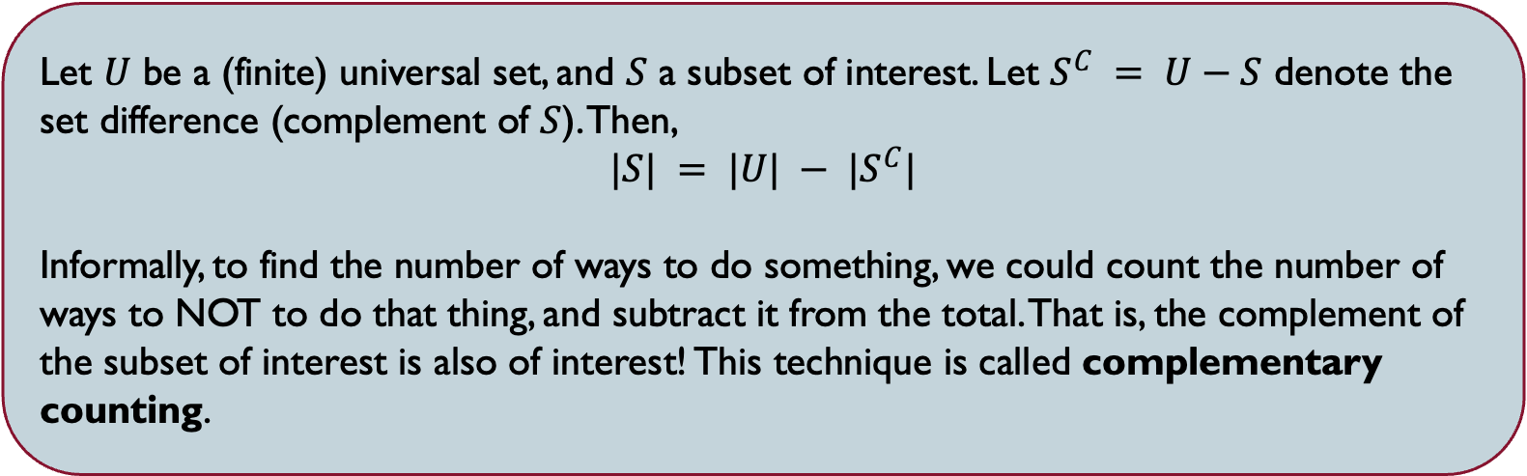
COMPLEMENTARY COUNTING
Let $U$ be a (finite) universal set, and $S$ a subset of interest. Let $S^{C} = U−S$ denote the set difference (complement of $S$). Then,
$$|S| = |U| − |S^{C}|$$
Informally, to find the number of ways to do something, we could count the number of ways to NOT to do that thing, and subtract it from the total. That is, the complement of the subset of interest is also of interest! This technique is called complementary counting.

Slide 22
COMPLEMENTARY COUNTING
Example. Suppose you are making a 10-digit PIN for your ATM, in which at least one digit has to be repeated at least once. How many such PINs exist?

Slide 23
SUMMARY
The definitions and notation for sets, intersection, union, complement.
Visualizing set operations using Venn diagrams.
Understand how counting is used computing probabilities.
Be able to use the rule of sum, rule of product, inclusion-exclusion principle, permutations and combinations to do counting.

Slide 24
One more thing …

Slide 25

v

